Slide 1

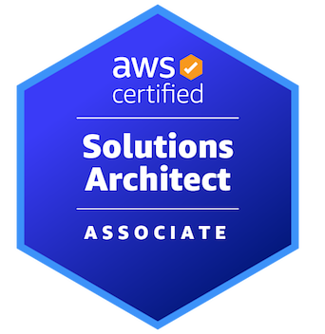

AWS CERTIFIED SOLUTIONS ARCHITECT - ASSOCIATE
Backup and Recovery
AMBER ISRAELSEN
Developer | Technical Trainer
Notes:
m17-01 = “Module Introduction”
Hi everyone, and welcome back to this next module in the course AWS Certified Solutions Architect – Associate. I’m still Amber Israelsen, and really appreciate you sticking with me.

Slide 2
Course Outline (Part 2)
Monitoring
Security and Compliance
Automation and Governance
DNS and Network Routing
Application Integration
Machine Learning
Backup and Recovery
Billing and Pricing
The Well-Architected Framework
Preparing for the Exam
Notes:
At this point in the course, we’ve seen so many individual services, and we know how to get applications and databases and so on up and running. But now we need to talk about what happens when it all goes wrong—how do we back up our data and recover from a disaster?
In this module, we’ll cover some fundamental concepts and terminology (click) —like RPO and RTO—or recovery point objective and recovery time objective. And then we’ll talk about backup features for various AWS services—like Elastic Block Store (EBS) and Relational Database Service (RDS).
Then we’ll (click) see how to automate your backups with Data Lifecycle Manager and (click) then also AWS Backup.
Let’s get started.

Slide 3
Terminology
RPO
RTO
Recovery point objective
Acceptable data loss
Expressed in hours
Example: With an RPO of 1 hour, you could lose up to 1 hour of data
Recovery time objective
Acceptable downtime
Expressed in hours
Example: With an RTO of 1 hour, systems should be up and running within 1 hour of disruption
Notes:
m17-02 = “Disaster Recovery Terminology and Strategies”
First, let’s review RPO and RTO.
(click) RPO stands for recovery POINT objective. And in the context of (click) SysOps and disaster recovery, this is acceptable data loss (click), expressed in hours. For example, let’s say your company has an RPO of 1 hour, that means you’re okay with losing up to 1 hour of data if disaster strikes.
On the other side (click), we have RTO or (click) recovery TIME objective. Here, rather than acceptable data loss, we’re (click) talking about acceptable downtime of your systems. This is also (click) expressed in hours. An example here would be (click) if you’ve got an RTO of 1 hour, that means your systems should be up and running again within 1 hour of disruption.

Slide 4

RPO vs. RTO
RECOVERY POINT OBJECTIVE (RPO)
RECOVERY TIME OBJECTIVE (RTO)
TIME
Lost data
When was your data last backed up BEFORE the disaster?
Downtime AFTER the disaster
Notes:
And just one more slide to illustrate the differences.
Here we have a timeline, and in the middle is some disaster that happened—a fire, an earthquake or some other type of disruption. For (click) RTO, again, this relates to time, and this is a measure of how much downtime you have AFTER the disaster.
Recovery (click) POINT objective has to do with your data, though, so what this is really saying is, when was your data last backed up BEFORE the disaster? Because whenever that was, say it was 1 day prior, that means you’re losing 1 day’s worth of data.

Slide 5
Disaster Recovery Strategies
BACKUP AND RESTORE
PILOT LIGHT
WARM STANDBY
MULTI-SITE ACTIVE/ACTIVE
LOW
HIGH
RPO/ RTO
HOURS
TENS OF MINUTES
MINUTES
REAL-TIME
COST
$
$$
$$$
$$$$
Lower priority use cases
Restore data after event
Deploy resources after event
Less stringent RPO/RTO
Core services
Start and scale resources after event
More stringent RPO/RTO
Business critical services
Scale resources after event
Zero downtime
Near zero loss
Mission critical services
Notes:
We’re going to talk about four options, and they run on a spectrum. For each, we’ll talk about the RPO, RTO, costs and some other points about when you’d want to choose each.
(click) Starting with Backup and Restore on the far left. And I’ll point out as we go that on the left we have low cost and low complexity, and then as we work our way to the right, we’re talking about high costs and high complexity.
With Backup and Restore, you’ve got an RPO/RTO measured in hours, and at the lowest cost of all the options. With this, you’ll be using things like snapshots of your EBS volumes and snapshots or backups of your databases. You can also S3 cross-region replication like we talked about in a previous module to copy your data into the recovery region.
(click) You’ll use this for lower priority use cases. And here, you’ll need to deploy both your data and your infrastructure to the recovery region after the event.
(click) Moving to the right, we have Pilot Light. With this option, you’re going to have a shorter RPO/RTO, measured in the tens of minutes. The cost will be higher because you’ll replicate your data to another region and (click) also make a copy of your core infrastructure in that region,. This means your core infrastructure is always available, unlike the Backup & Restore option we just talked about. With this option, you’ll be using things like S3 replication, RDS read replicas, Aurora global databases and DynamoDB global tables.
(click) Moving to our next option, warm standby. With this option, you’re getting an improvement in RPO/RTO, but at an increased cost. (click) Here, you’ll have a fully functional but scaled-down version of your production environment in another region. Which sounds very similar to Pilot Light. The difference between the two is that Pilot Light requires you to turn on servers and possibly deploy additional non-core infrastructure. Whereas with warm standby, you can handle traffic immediately in the recovery region, though it may temporarily be at reduced capacity.
(click) And then finally, we have multi-site active-active, which has real-time RPO/RTO and is going to be the most expensive option. Here, you’ve got a fully-functioning environment in multiple regions and traffic is being directed to all regions. This means you’ve got near-zero recovery time and data loss in the event of a disaster. This should be used for mission-critical services. In addition to the AWS services used in the other options, here, you’ll probably also be using Route 53 and AWS Global Accelerator to route traffic to the active region.
Now, it should go without saying, but it’s really important to regularly test your recovery paths. It doesn’t do you any good to have a disaster recovery plan that nobody knows how to use, or that fails when you go to execute it.
https://docs.aws.amazon.com/wellarchitected/latest/reliability-pillar/rel_planning_for_recovery_disaster_recovery.html

Slide 6
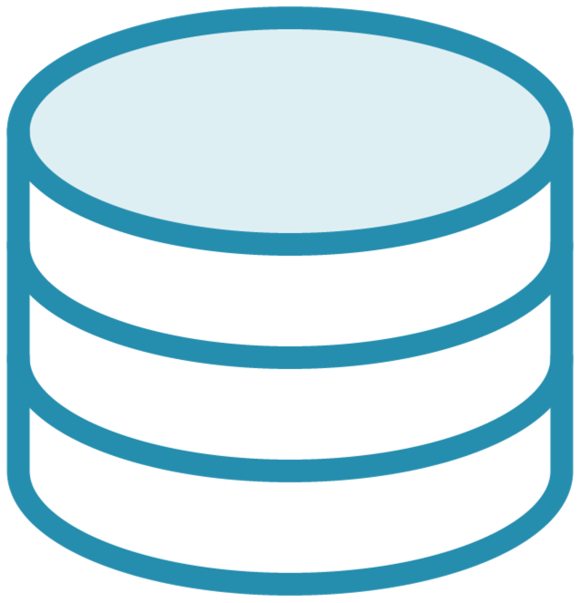
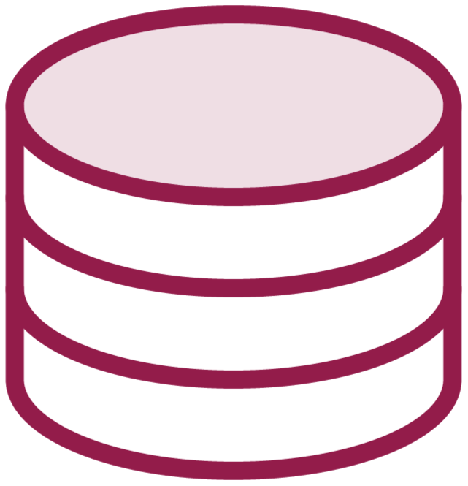
Testing Recovery Paths
Primary database
Secondary database, read-only
Notes:
For example, maybe you have a setup where you’ve got a (click) primary database and then a (click) secondary database that’s read-only, to help give users better performance.

Slide 7
Testing Recovery Paths
Primary database
Secondary database, read-only
Notes:
And your recovery path says if that primary database goes down, you need to failover to that secondary database. Try this out. Take your primary database offline and make sure things successfully transition over.
Or if you’re doing something like backup and restore, take one of your backups, restore it, and make sure that you can then direct traffic to it.

Slide 8


Testing Recovery Paths
Load balancer and auto scaling
[
]
EC2 instances
Notes:
Maybe you’ve got load balancers that are working with auto scaling groups so that the number of instances you have get scaled up or down. Or unhealthy instances get automatically replaced.

Slide 9
Testing Recovery Paths
Load balancer and auto scaling
[
]
EC2 instances
Notes:
Test this out. Take one of your instances offline and make sure that you’ve got everything configured correctly to spin up a new one.

Slide 10
Backup Features for Various AWS Services
 | Backup Features
Elastic Block Storage (EBS) | Snapshots of EBS volumes Stored in S3
Relational Database Service (RDS) | Automated backup; RDS does a full daily snapshot Single region Snapshots; user-initiated Cross-region Read replicas Used for scalability, but can also be used for recovery by promoting a replica Cross-region
DynamoDB | On-demand table backups
Storage Gateway | Back up on-premises files, applications, databases, and volumes to AWS
Notes:
m17-03 = “Overview of Backup Features in AWS”
Let’s talk through some backup options for the different AWS services. We’re only going to cover four here, but there are more services than this that offer backup features.
I’ll draw your (click) attention to the top row, for Elastic Block Storage or EBS. You’ll recall that EBS volumes are basically the virtual disks for your EC2 instances or your virtual machines in AWS. To back these up, you’ll take snapshots. And the first snapshot you take will be a full snapshot of the state of the volume at that time, and subsequent snapshots will just be incremental, or the delta between that snapshot and the previous. And the snapshots are going to be stored in S3, though you can’t just directly go into S3 and manage them; you’ll need to use the EBS tools.
Next up, backup features for (click) RDS or the Relational Database Service. You’ve got a few options here, first being automated backups. Here, RDS will automatically perform a full snapshot each day during a preferred time window that you set. These are limited to a single region.
Then you’ve got snapshots, which you’ll initiate as often as you’d like. And these can be cross-region.
And finally, we have read replicas. In practice, read replicas are a great way to scale your application. Say you have a news site that has heavy reads, but not a lot of writes. You can redirect that read traffic to a database replica, making things faster for your users. But you can also use read replicas for disaster recovery. If your primary database fails, you can promote the read replica to be your primary database. This also supports cross-region.
Moving on to (click) DynamoDB, here you can do on-demand backups of database tables, and the entire table is backed up.
And finally (click) Storage Gateway. There are a few types here: file, volume and type. And Storage Gateway allows you to back up on-premises files, applications, databases and volumes to AWS.
Now let’s talk about how to automate this.

Slide 11
Backup Features for Various AWS Services
 | Backup Features
Elastic Block Storage (EBS) | Snapshots of EBS volumes Stored in S3
Relational Database Service (RDS) | Automated backup; RDS does a full daily snapshot Single region Snapshots; user-initiated Cross-region Read replicas Used for scalability, but can also be used for recovery by promoting a replica Cross-region
DynamoDB | On-demand table backups
Storage Gateway | Back up on-premises files, applications, databases, and volumes to AWS
Notes:
m17-04 = “DEMO: Data Lifecycle Manager Overview”
Referring back to this table we saw earlier, let’s talk about this first row here, for Elastic Block Store or EBS backups.
And if we go into the AWS Console (do this), we could:
-Go to the EC2 dashboard
-Under EBS, go to Snapshots
-And we could create a snapshot manually
Easy-peasy. But wouldn’t it be nice if you could automate that to run every day or every 8 hours or whatever you choose?

Slide 12


Options for Automating Backups in AWS
Data Lifecycle Manager
(for EBS only)
AWS Backup
(for multiple services)
Notes:
There are two options for automating snapshots and backups in AWS, and you’ll need to know the difference between these for the exam.
The first (click) is Data Lifecycle Manager—and this is for EBS only, creating those snapshots we just talked about.
The (click) second is AWS Backup, which lets you do backups for multiple services—say, EBS and EFS and RDS—all from a single interface.

Slide 13
DEMO
Working with Data Lifecycle Manager
Notes:
So let’s go out and do a short demo on Data Lifecycle Manager. We’ll see how to create a lifecycle policy and how to validate the automation.
SETUP: Create an instance and tag its volume with environment = prod
We’ll start in the EC2 console, then under Elastic Block Store, click on Lifecycle Manager
Then we’ll want to create a lifecycle policy—that’s what will allow us to schedule our EBS snapshot.
You’ll see a few different options for policy type. We’re going with the first one, EBS snapshot policy. Next step
For resource type, Volume will let you create a backup of a single volume. And Instance will allow you to snapshot multiple volumes attached to a single EC2 instance.
We’re going to say Volume. For description, say Daily EBS Volume Snapshot Policy.
Target tags: environment = prod
Next, you’ll need to select an IAM role that has permissions to create, delete and describe snapshots. For what we’re doing, we’ll select the default role, but you can create a new one as well.
And then we need to get into the details of scheduling.
Name: Daily EBS Volume Snapshot Schedule
Frequency: Daily
Every: 24 hours
Starting at: Choose something 5 minutes from now
Retention type: We can retain snapshots either by their age or total count. We’ll say we want to retain by count 6. That means anything more than 6 will be automatically deleted.
Defaults, next, Create
My policy was created and it’s enabled.
The last thing we want to do is ensure that it runs. Remember we set it to run at _________ UTC. If we look at the list of Snapshots now, there aren’t any. I’ll pause the video for a couple minutes and then come back to show that it ran.
Now show that the snapshot was created by the automation.
So there you go. That’s how you would automate snapshotting of EBS volumes using Data Lifecycle Manager.
Delete policy and snapshot

Slide 14
Options for Automating Backups in AWS
Data Lifecycle Manager
(for EBS only)
AWS Backup
(for multiple services)
Notes:
m17-05 = “DEMO: Creating a Backup with AWS Backup”
In our last clip, we saw how to automate backup functionality using Data Lifecycle Manager for EBS.
Now let’s look at the second option of AWS Backup that works with multiple services.

Slide 15
Backup Features for Various AWS Services
 | Backup Features
Elastic Block Storage (EBS) | Snapshots of EBS volumes Stored in S3
Relational Database Service (RDS) | Automated backup; RDS does a full daily snapshot Single region Snapshots; user-initiated Cross-region Read replicas Used for scalability, but can also be used for recovery by promoting a replica Cross-region
DynamoDB | On-demand table backups
Storage Gateway | Back up on-premises files, applications, databases, and volumes to AWS
Notes:
We saw previously that individual services have their own backup features—and there are more than just those listed here. And that will remain the case whether you use AWS Backup or not. You can just individually go in and do backups on your EBS volumes, your RDS databases, your DynamoDB tables and so on.
But AWS Backup will let you tie all of those together to manage backups in a single place.

Slide 16
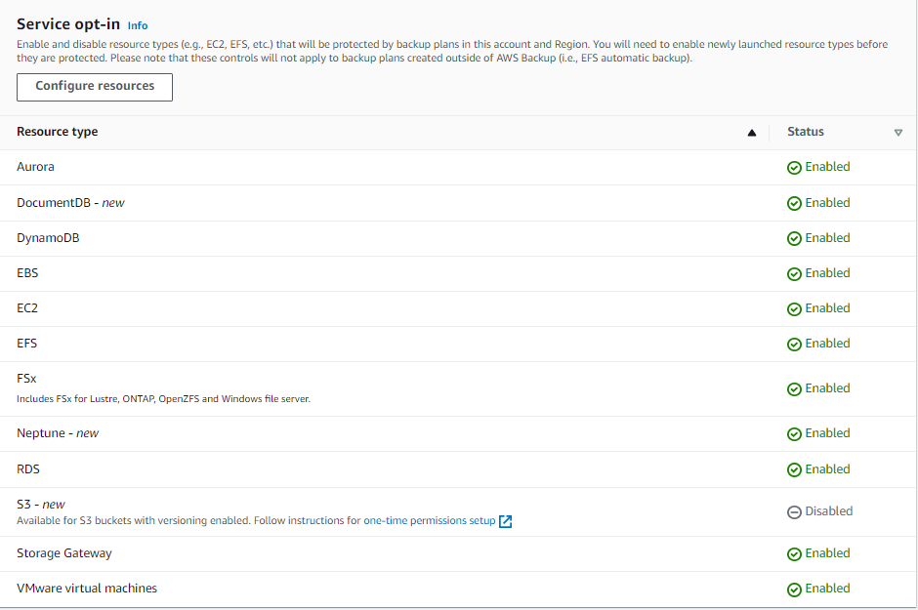
Enabling AWS Backup for Services
Notes:
Within AWS Backup, you’ll enable (or disable) the things you want to back up—and here you’ll see the full list, some of which we already talked about. Once you’ve enabled them to work with AWS, you can set them up on a schedule, similar to what we saw with Lifecycle Manager.
Let’s take a look in a demo…

Slide 17
DEMO
Creating a Backup with AWS Backup
Notes:
In this demo (click), we’ll see how to enable AWS Backup (click) to work with different services and then (click) we’ll create a scheduled backup.
SETUP: Set up an EFS, Name: MyEFS
Delete old manually-created backup plans
In the AWS Console, we’ll navigate to AWS Backup, and then on the left nav, go to Settings.
You’ll see that all of these are enabled by default, but if you Configure, then you can toggle individual services on and off. And note that these settings are region-specific, so you’ll need to configure each region for your needs.
Now let’s create a backup plan. The backup plan is where we define our requirements, the schedule, and lifecycle and retention rules. Navigate to Backup plans (left nav). Create Backup plan.
There are templates available, but to better show you some of the options available, we’ll Build a new plan
Name: daily-30-day-retention
Backup rule name: daily-backup
Backup vault: This is where the backups will be stored; create new called my-backup-vault, default KMS key
Backup frequency: Daily
Backup window: Use defaults, but show that you could also customize, and those options:
You can choose to transition your backups to cold storage, but we’re going to leave that at Never
And then retention, we’re only going to keep these for 30 days. So we’ll say Days and 30.
You can choose to create a copy in another region, but we’ll skip that for now.
Now, you might be wondering where we specify the resources to back up. And you’ll see the note at the bottom here, that you can assign resources after the plan is created. So let’s do that, Create plan.
NOW we can assign resources.
Name: daily-30-day-resources
Role: Default
Include specific resource types
Assign by: Resource ID→EFS→it shows available file system IDs
Add assignment
Assign by: Resource ID→EBS→it shows available volume IDs
Assign resources
And there we go. Now every day at the default time, the job will run and will get stored in the backup vault (show this).
And back under Backup plans, you will be able to see last runtime so you’ll know it ran. I won’t make you wait around for mine, but if you’re following along a home, feel free to check back on your own vault to see the results.
So that wraps it up for this demo.
Delete vault, resource assignments (open backup plan to see/delete this), backup plan, EFS drive

Slide 18
DEMO
Restoring an RDS Database to a Point in Time
Notes:
m17-06 = “DEMO: Restoring a RDS Database to a Point in Time”
In this demo, we’ll see how to restore a database to a point in time. And for this, I’ll be using the AWS Console, but you can also use the command line interview, or CLI, or the RDS API.
SETUP: Create a database and have some automated backups available
Delete the previous “database-restored” database
Now, prior to this demo, I went into the RDS console and created a MySQL database, and you’ll see I have some automated backups available (show this). Note that each backup has an earliest restorable time and a latest restorable time. I’ve got a range here of ____________. You can restore to any time between these two points.
So let’s say we want to restore database-1. Choose this and then Actions→Restore to point in time
I’m going to say that I want to restore this to the latest point in time, but you can also choose Custom to choose another time.
Then we need to give this restored instance a name: database-restored
Keep everything else the default, but note that you ARE able to change various things
And Restore to point in time
Coming back to Databases, you’ll see that it’s now listed alongside my original database. So we’ve taken that backup and restored it to a point in time as a new database instance.
To next slide before ending

Slide 19
Restoring an RDS Database to a Point in Time
Restoring to a specific point in time creates a new database instance
Recommended to restore to the same or similar database instance size
AWS Backup can also be used to restore an RDS database to a point in time
Notes:
There are a few important things to know for this one.
First, when you restore to a specific point in time, that will create a new database instance for you. You’re not restoring just the database, or just the database tables, for instance, to an existing database instance. But you’ll be getting a brand-new database instance.
Second, when you go to restore to a point in time, the recommendation is to choose the same or similar database instance size as what you had before—and you’ll see an option in the UI for this.
And then finally, thinking back to our discussion about AWS Backup in the last module, you CAN use AWS Backup to do all of this work, in addition to doing it individually through the RDS tooling.
Delete the new DB instance and backup

Slide 20
DEMO
Restoring an RDS Database from a Snapshot
Notes:
m17-07 = “DEMO: Restoring a RDS Database from a Snapshot”
In this demo, we’ll restore from a database snapshot. Once again, we’ll be in the AWS Console, but you can also use the CLI or the RDS API.
SETUP: Create a database and have a snapshot available
To set up for this demo, I took a snapshot of my database, and so you’ll see I have database-snapshot here (show under Snapshots).
And it’s super easy to restore from a snapshot. Just select the snapshot you want to restore from, go to Actions→Restore Snapshot (if this doesn’t work, click into the snapshot and then go to that Action menu)
ID: database-snapshot-restored
Defaults, but call out the storage type
Restore DB Instance
And once again, under Databases, you’ll see that restored snapshot is listed and being created. Pretty easy, huh?
To next slide before ending demo…

Slide 21
Restoring an RDS Database from a Snapshot
Restoring from a snapshot creates a new database instance
You can restore from a snapshot and choose a different storage type
Notes:
Some important points to note on this option.
Just like we saw with restoring to a point in time, restoring from a snapshot also creates a new database instance.
And you can restore from a snapshot and choose a different storage type for the new database instance—for instance, changing from general purpose SSD storage to something like provisioned IOPS.
Delete the new DB instance and snapshot

Slide 22
Encryption: Restoring an RDS Database from a Snapshot
You can copy a snapshot that’s been encrypted using a KMS key (copy will also be encrypted)
Same region = same key
Different region = specify the key in region
You can encrypt a copy of an unencrypted snapshot (adding encryption to a previously-unencrypted DB instance)
Create a snapshot of the DB instance
Create a copy of the snapshot and specify a KMS key to encrypt the snapshot
Restore an encrypted DB instance from the encrypted snapshot
Notes:
And then let’s spent a minute on how encryption works with database snapshots. This could come up on the exam, so make sure you understand the options.
If you have a snapshot that’s been encrypted with a KMS key, you can copy that snapshot, and the copy will also be encrypted.
If you’re making the copy in the same region as the snapshot, you’ll use the same KMS key that was used for the encryption of the snapshot
If you’re putting the copy in a different region, then you’ll need to specify the KMS key in that region, so it’ll be different than the key that was used for the snapshot
You can also encrypt a copy of an unencrypted snapshot. This way, you can quickly add encryption to a previously unencrypted DB instance. To do this, you create a snapshot of your DB instance when you are ready to encrypt it. You then create a copy of that snapshot and specify a KMS key to encrypt that snapshot copy. You can then restore an encrypted DB instance from the encrypted snapshot.

Slide 23
DEMO
Promoting an RDS Read Replica
Notes:
m17-08 = “DEMO: Promoting a RDS Read Replica”
As mentioned previously in the course, you can use read replicas to improve performance for your users. If you’ve got an application that’s very read-heavy, you can create a read replica of the database, and direct read traffic there. So it’s a good way to scale out capacity for those types of workloads.
But it can also be used as a form of backup if something goes wrong with your primary database.
In this demo, we’ll take a read replica and promote it using the AWS Console.
SETUP: Create a database and have a read replica available
Previously, I went to my database and created a read replica from it. One thing you’ll notice, though, is there is no “read replica” label on the left nav. Instead, you’ll go to Databases, and then under Role, you’ll see there’s a role for Replica.
So let’s say that for whatever reason, my primary database, database-1, goes down and I need a way to recover my data. I can take database-read-replica and promote it to be my primary.
To do that, select the replica, and then Promote (might have to click into replica)
Leave defaults
Continue
Then you’ll get a warning of sorts that you should stop any transactions on the master. Otherwise, the read replica might not have everything committed to it. For what we’re doing, this is fine, but in the real world, depending on why you’re promoting the read replica, you may need to do some coordination. You’ll see it also mentions the reboot here.
For what we’re doing, this is fine. We’ll Promote Read Replica.
After that’s done, let’s go back and take a look at what’s showing in our list of Databases.
You can watch the status if you want (Replica will show Modifying, Rebooting→at this point, the role is now Instance, not replica)
Pause video and come back
And that’s how you take a database read replica and promote it to be a database instance.
To next slide before ending demo

Slide 24
Promoting a Read Replica
When promoting a read replica, the database instance is rebooted (so will take some time)
After promoting, it is the same as any other database instance
Notes:
A couple of important things to note here.
When you promote a read replica, it’ll take a little bit of time until it’s available, and this is because the database instance will reboot, so keep that in mind.
And then after you promote it, it’s just the same as any other database instance. In other words, you can no longer use it as a replica. But you can do all the same things you can do with a regular database like snapshotting, creating a new read replica from it and so on.
Delete the new DB instance and replica

Slide 25

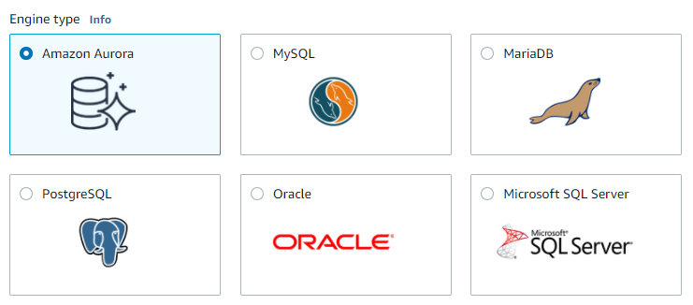

Amazon RDS and Aurora
RDS
Aurora
Notes:
m17-09 = “Disaster Recovery with Amazon Aurora”
We touched briefly on Amazon Aurora in our database module, kind of lumping it in with the Relational Database Service or RDS. And there are definitely similarities and overlap. For example, RDS supports all of the database engines here—PostgreSQL, MySQL, MariaDB, Oracle and Microsoft SQL Server. And then (click) Aurora only supports PostgreSQL and MySQL.
But some of the differences and benefits of Aurora really become apparent when we get into disaster recovery scenarios.

Slide 26
Amazon RDS and Aurora
Enable Multi-AZ and replicate to a standby replica in another AZ to achieve high availability/ reliability
RDS
Aurora
Fault-tolerant and reliable by design
Notes:
For example, with RDS, you have to enable the multi-AZ feature and replicate to a standby replica in another AZ to achieve high availability and reliability.
Whereas with Aurora, it’s fault-tolerant and reliable by design. You get a lot more for “free.”

Slide 27


Aurora DB Cluster
Availability Zone 1
Availability Zone 2
Availability Zone 3
Compute is separate from storage
Compute is separate from storage
Primary instance
Read
Write
Cluster Volume
Notes:
And the reason for this is because of how it’s architected. With Aurora, compute is separated from storage.

Slide 28

Aurora DB Cluster
Availability Zone 1
Availability Zone 2
Availability Zone 3
Primary instance
Read
Write
Write
Data copies
Data copies
Data copies
Notes:
And it keeps 6 copies of your data across three Availability Zones. So even if you only have a single primary instance, you still have 6 copies of your data being

Slide 29
Can have up to 15 replicas (which can serve queries almost immediately)
Aurora DB Cluster
Availability Zone 1
Availability Zone 2
Availability Zone 3
Primary instance
Replica
Replica
Replica
Read
Read
Read
Read
Write
Write
Write
Data copies
Data copies
Data copies
Notes:
But then you can also have read replicas, up to 15. And these can serve up queries almost immediately.

Slide 30
Aurora DB Cluster
Availability Zone 1
Availability Zone 2
Availability Zone 3
Primary instance
Replica
Replica
Replica
Read
Read
Read
Read
Write
Write
Write
Data copies
Data copies
Data copies
Cluster volume backed up automatically; no performance impact
Notes:
For backups, the cluster volume—or your data, basically—is backed up automatically. And there’s no performance impact from these backups.

Slide 31
Failover to replicas is fast and happens automatically
Aurora DB Cluster
Availability Zone 1
Availability Zone 2
Availability Zone 3
Primary instance
Replica
Replica
Replica
Read
Read
Read
Read
Write
Write
Write
Data copies
Data copies
Data copies
Notes:
And as far as failover, at least in a single-region scenario, which is what we’ve covered so far—the failover happens to a replica, and it happens automatically.

Slide 32
Aurora DB Cluster
Availability Zone 1
Availability Zone 2
Availability Zone 3
In short, backup and recovery are faster and require less effort with Aurora than with RDS
Primary instance
Replica
Replica
Replica
Read
Read
Read
Read
Write
Write
Write
Data copies
Data copies
Data copies
Notes:
So in short, backup and recovery are faster and require less effort with Aurora than with RDS. On the exam, if you get questions about needing a design that’s fault-tolerant, highly performant, scalable and so on, then the solution will most likely be Aurora over RDS.

Slide 33
Additional Aurora Features Multi-Master vs. Global Database
MULTI-MASTER
GLOBAL DATABASE
All DB instances have read/write capability (instead of just one)
Applies to a single region
Failover: If a writer DB instance becomes unavailable, another writer takes over automatically
A single Aurora database spans multiple regions (up to 5) (i.e., replicas are in other regions)
Writes are issued to primary region, then replicating to other regions (with no impact to performance)
Failover: A secondary region is promoted to primary region
Notes:
m17-10 = “Amazon Aurora Multi-Master and Global Databases”
We touched briefly
A few other notes here about Aurora as it relates to backup and recovery. There are two additional features of Aurora—and that is a multi-master database and a global database. They’re similar, but different so let’s go into these differences.
With multi-master, all of your database instances have read/write capabilities.
Next slide

Slide 34
Aurora DB Cluster
Availability Zone 1
Availability Zone 2
Availability Zone 3
Primary instance
Replica
Replica
Replica
Read
Read
Read
Read
Write
Write
Write
Data copies
Data copies
Data copies
Notes:
So rather than this, where your primary instance is the only one doing the writes…

Slide 35
Aurora DB Cluster
Availability Zone 1
Availability Zone 2
Availability Zone 3
Primary instance
Replica
Replica
Replica
Read
Read
Read
Write
Write
Write
Data copies
Data copies
Data copies
Notes:
All of them have read-write capabilities.

Slide 36
Additional Aurora Features Multi-Master vs. Global Database
MULTI-MASTER
GLOBAL DATABASE
All DB instances have read/write capability (instead of just one)
Applies to a single region
Failover: If a writer DB instance becomes unavailable, another writer takes over automatically
A single Aurora database spans multiple regions (up to 5) (i.e., replicas are in other regions)
Writes are issued to primary region, then replicating to other regions (with no impact to performance)
Failover: A secondary region is promoted to primary region
Notes:
(Go to second bullet on the left)
This only applies to a single region. We’ll talk about cross-region in a second.
And so as far as failover goes, if a writer database—which is all of them—becomes unavailable, then another writer takes over automatically. Quick and easy.
Then on the other side, the global database, with this, a single Aurora database spans multiple regions, up to 5.
Next slide…

Slide 37
Aurora DB Cluster
Availability Zone 1
Availability Zone 2
Availability Zone 3
Primary instance
Replica
Replica
Replica
Read
Read
Read
Read
Write
Write
Write
Data copies
Data copies
Data copies
Notes:
So rather than your replicas just being in different Availability Zones…

Slide 38
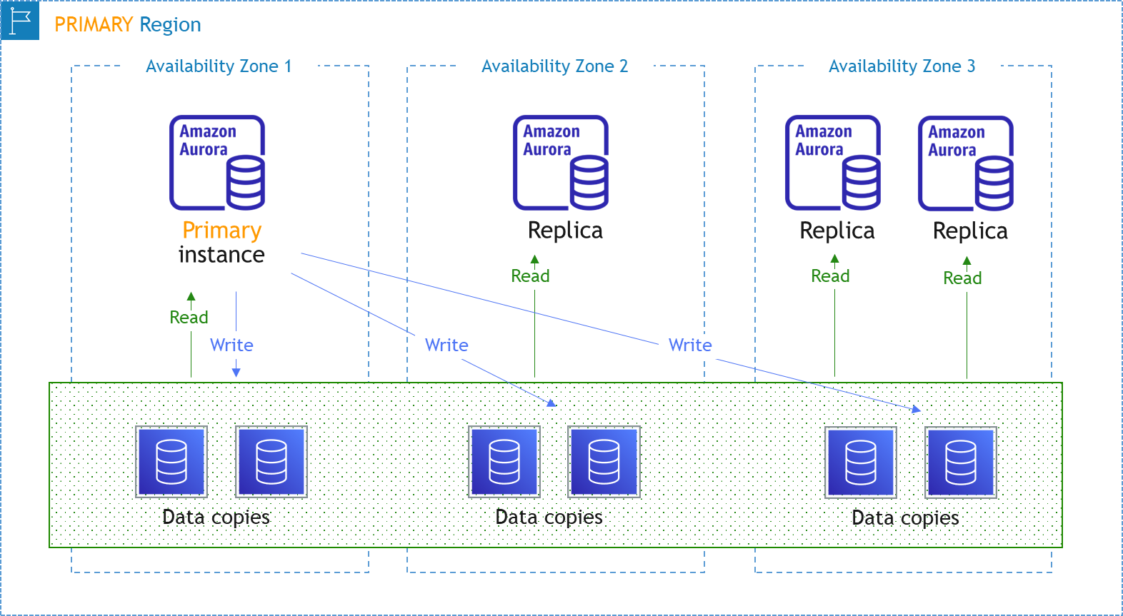
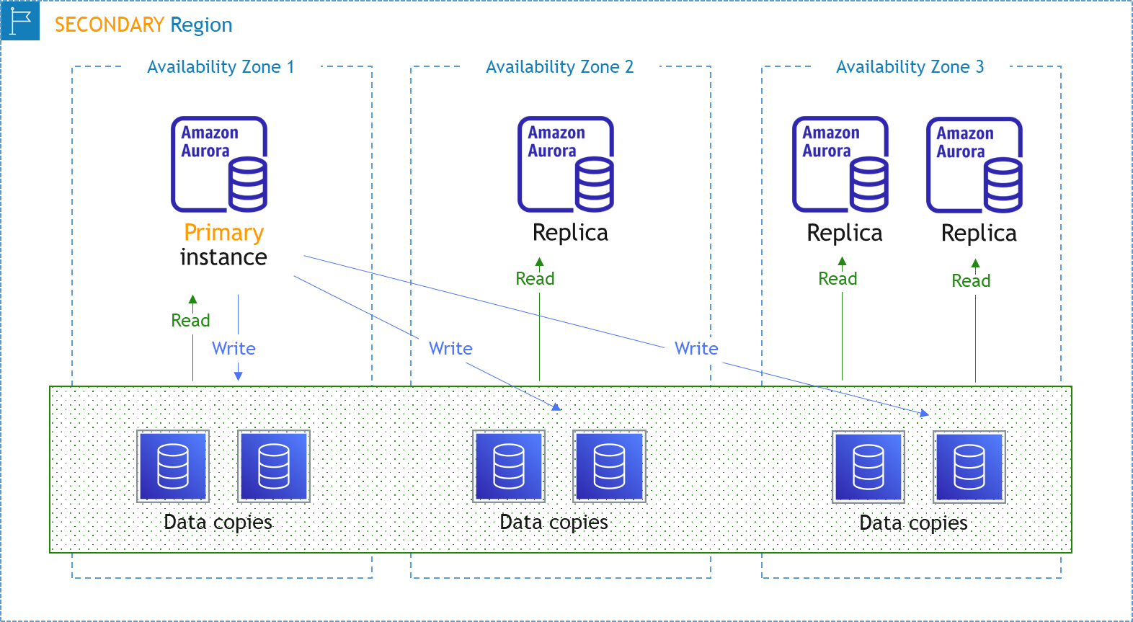
REPLICATION
Notes:
They’re actually in different regions. You have a primary region and then secondary regions, and replication happens between them.

Slide 39
Additional Aurora Features Multi-Master vs. Global Database
MULTI-MASTER
GLOBAL DATABASE
All DB instances have read/write capability (instead of just one)
Applies to a single region
Failover: If a writer DB instance becomes unavailable, another writer takes over automatically
A single Aurora database spans multiple regions (up to 5) (i.e., replicas are in other regions)
Writes are issued to primary region, then replicating to other regions (with no impact to performance)
Failover: A secondary region is promoted to primary region
Notes:
(Go to second bullet on the right)
So writes are still issued to the primary region, and then replicated to other regions, like we just said. There’s no impact to performance when this happens.
And then for failover, basically a secondary region is promoted to the primary region. And there are some different scenarios depending on whether it’s planned or unplanned, but for the exam, know that if you need cross-region failover, then you want a global database. If you need failover in a single region, then a multi-master setup can give you that by giving every database read/write capabilities.

Slide 40
Important Points to Remember
DISASTER RECOVERY
Recovery Point Objective (RPO): Has to do with data loss; when was data last backed up BEFORE a disaster?
Recovery Time Objective (RTO): Related to the downtime AFTER a disaster
Pilot Light: Tens of minutes; start and scale resources after an event (core services)
Warm Standby: Minutes; scale resources after an event (business critical services)
Multi-site/Active-Active: Zero downtime (mission critical services)
DATA LIFECYCLE MANAGER
Used for backup and recovery of EBS volumes (only)
AWS BACKUP
Used to do backups for multiple services (EBS, EFS, RDS, etc.) all from a single interface
Notes:
m17-11 = “Important Points to Remember”

Slide 41
Important Points to Remember
BACKUP AND RESTORE WITH RDS
Automated backups; RDS does a full daily snapshot (single region)
Snapshots; user-initiated (cross-region)
Read replicas (cross-region)
Restoration: To a point in time; From a snapshot; Promoting a read replica
BACKUP AND RESTORE WITH AURORA
Generally going to be faster and require less effort
Multi-Master: All DB instances have read/write capability (single region); if writer becomes unavailable, another takes over
Global Database: Spans up to 5 regions; during failover, a secondary region promoted to primary

